Slide 1
SANTHOSHINI M
Final Project
3/21/2024 Annual Review

Slide 2
ARTISTIC STYLE TRANSFER WITH CNN
3/21/2024 Annual Review

Slide 3


AGENDA
Problem Statement
Introduction to the challenge of transferring artistic style to images while preserving content.
Project Overview
Overview of the project aims and objectives in implementing artistic style transfer with CNNs.
End Users
Identification of potential end users and beneficiaries of the artistic style transfer application.
Our Solution
Description of our approach in utilizing CNNs for artistic style transfer, emphasizing efficiency and effectiveness.
The "Wow" in Our Solution
Highlighting unique features or innovations that set our solution apart from existing methods.
Modeling
Explanation of the neural style transfer algorithm and the role of CNNs in feature extraction.
Results
Presentation of the outcomes and visualizations obtained from applying our solution to sample images.
Conclusion
Summary of key findings and implications, concluding with the project's significance and potential future directions.
3/21/2024 Annual Review

Slide 4

PROBLEM STATEMENT
Artistic style transfer aims to seamlessly blend the artistic style of one image with the content of another.
This process presents a unique challenge in computer vision, requiring algorithms to preserve the original content while incorporating the desired style elements.
Despite recent advancements, achieving a balance between content preservation and style transfer remains a significant hurdle in the field.
3/21/2024 Annual Review

Slide 5

PROJECT OVERVIEW
Our project focuses on implementing artistic style transfer using convolutional neural networks (CNNs).
By leveraging the power of deep learning, we aim to develop a system capable of transferring the style of one image onto another while preserving the content of the latter.
Through this project, we seek to explore the potential applications of artistic style transfer in various domains, including digital art, photo editing, and visual effects.
3/21/2024 Annual Review

Slide 6

WHO ARE THE END USERS?
Our project targets a diverse range of end users, including artists, designers, photographers, and enthusiasts interested in digital image manipulation.
Additionally, professionals in industries such as advertising, marketing, and entertainment may benefit from the application of artistic style transfer techniques to enhance visual content creation and production processes.
By providing a user-friendly interface and accessible tools, our solution aims to empower both novice and experienced users to explore and apply artistic style transfer in their respective fields.
3/21/2024 Annual Review

Slide 7
YOUR SOLUTION AND ITS VALUE PROPOSITION
Our solution leverages convolutional neural networks (CNNs) to implement an efficient and effective artistic style transfer algorithm.
By combining state-of-the-art deep learning techniques with user-friendly interfaces, our solution offers a seamless and intuitive platform for transferring artistic styles onto images while preserving their original content.
The value proposition lies in providing users with a powerful yet accessible tool for creative expression, enabling them to generate visually stunning artworks and enhance their digital content with unique and personalized styles.
3/21/2024 Annual Review

Slide 8

THE WOW IN YOUR SOLUTION
Our solution introduces innovative techniques to enhance the artistic style transfer process.
By leveraging advanced CNN architectures and optimization strategies, we achieve remarkable results in seamlessly blending artistic styles with content images.
Additionally, our solution offers real-time processing capabilities, allowing users to interactively explore various style transfer options and visualize instant transformations.
The "wow" factor lies in the unprecedented level of flexibility, speed, and quality delivered by our solution, revolutionizing the way artistic styles are applied to digital images.
3/21/2024 Annual Review

Slide 9
MODELLING
Our modeling approach utilizes convolutional neural networks (CNNs) to extract meaningful features from both content and style images.
We employ pre-trained CNN models, such as VGG19, to capture hierarchical representations of image content and style across multiple layers.
By optimizing a combination of content and style loss functions, our model learns to generate output images that preserve the content of the input while incorporating the desired artistic style.
Through this hierarchical feature extraction and loss optimization process, our model achieves superior performance in artistic style transfer tasks.
3/21/2024 Annual Review

Slide 10
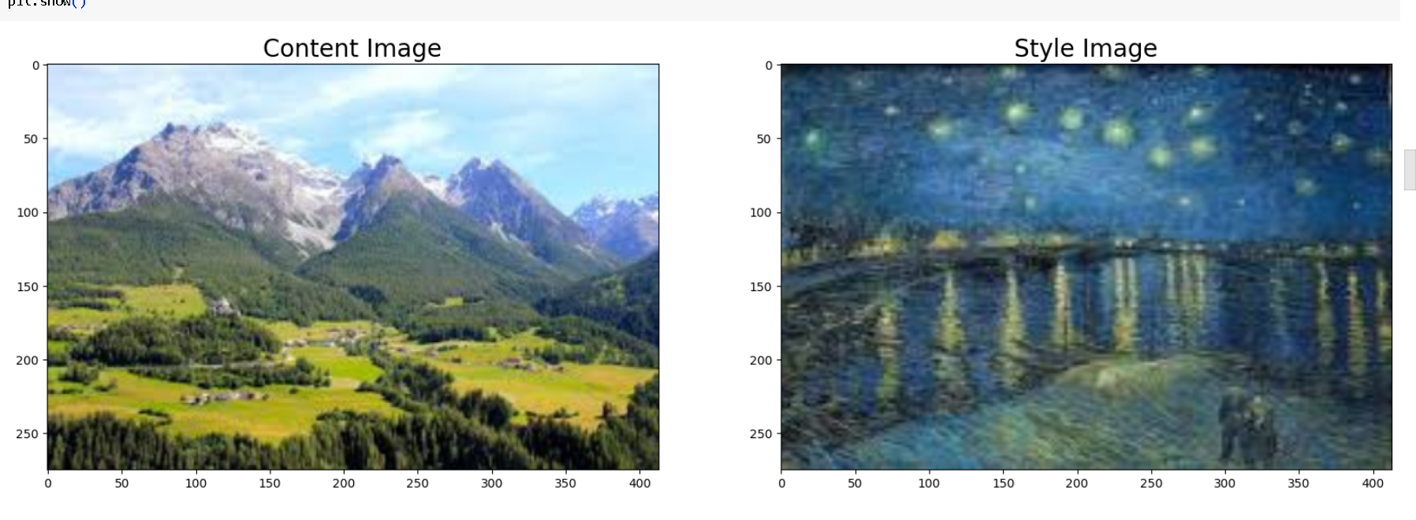
RESULTS
INPUT IMAGES
Demo Link
3/21/2024 Annual Review

Slide 11
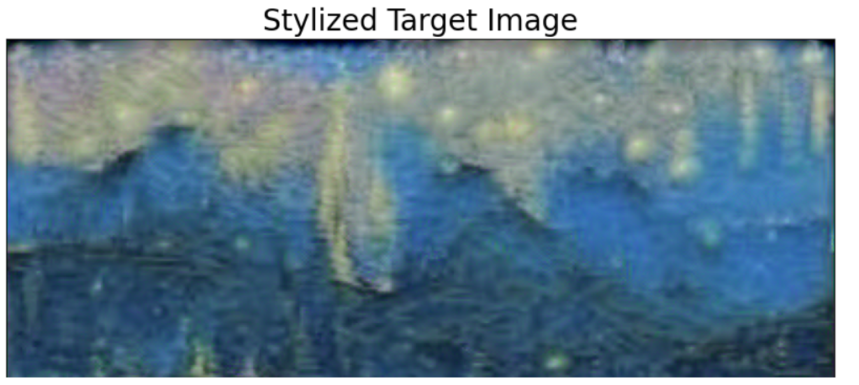
RESULTS
OUTPUT IMAGE

